Slide 1


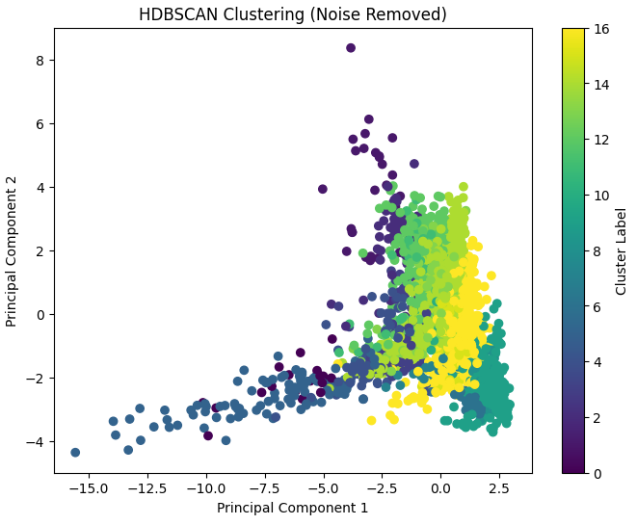
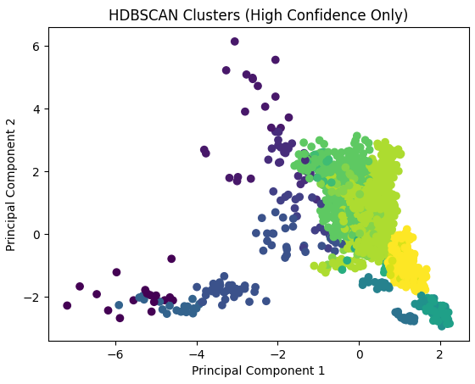
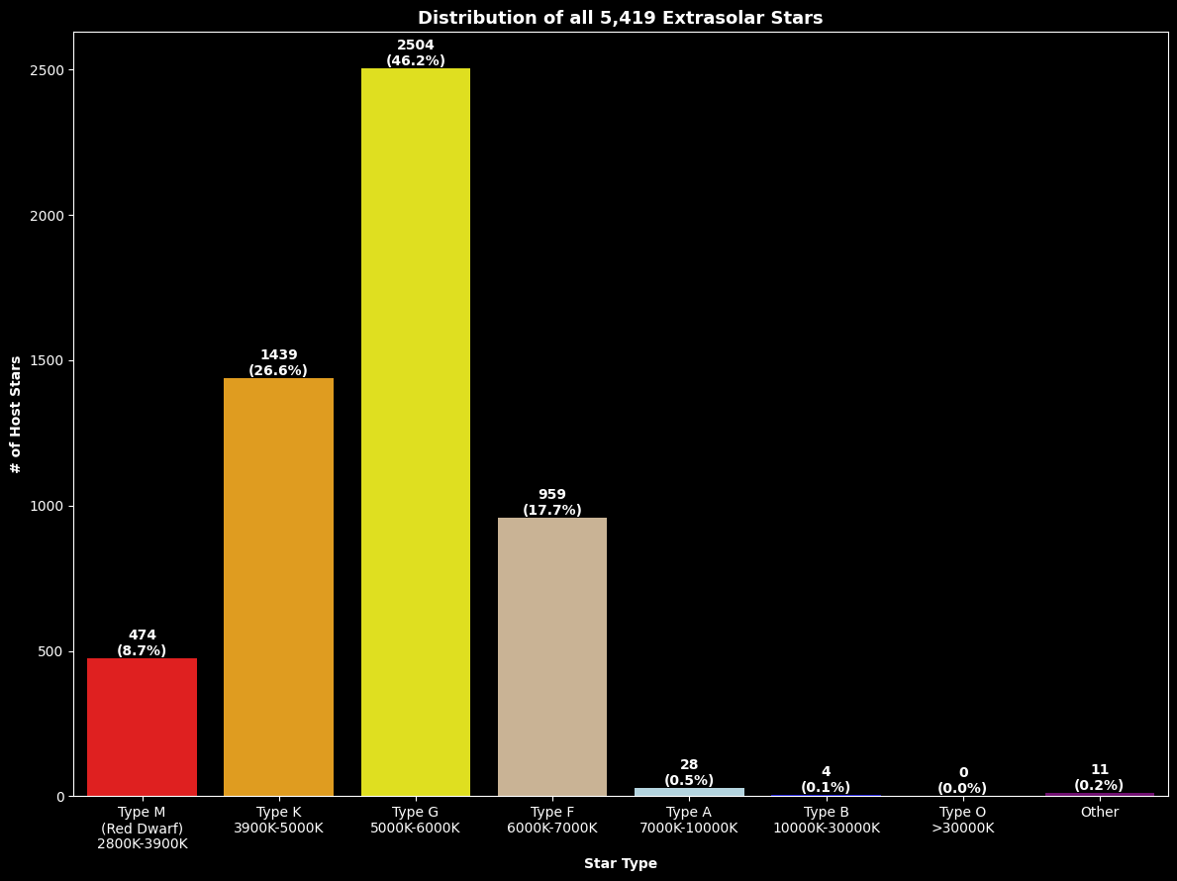
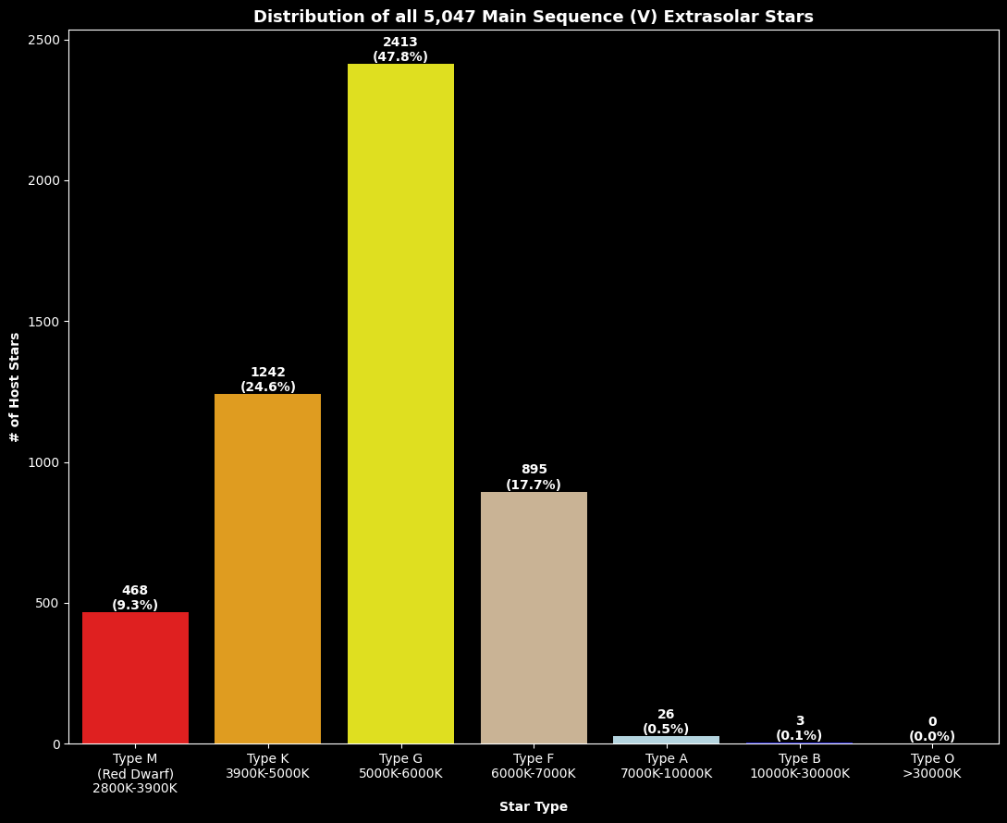
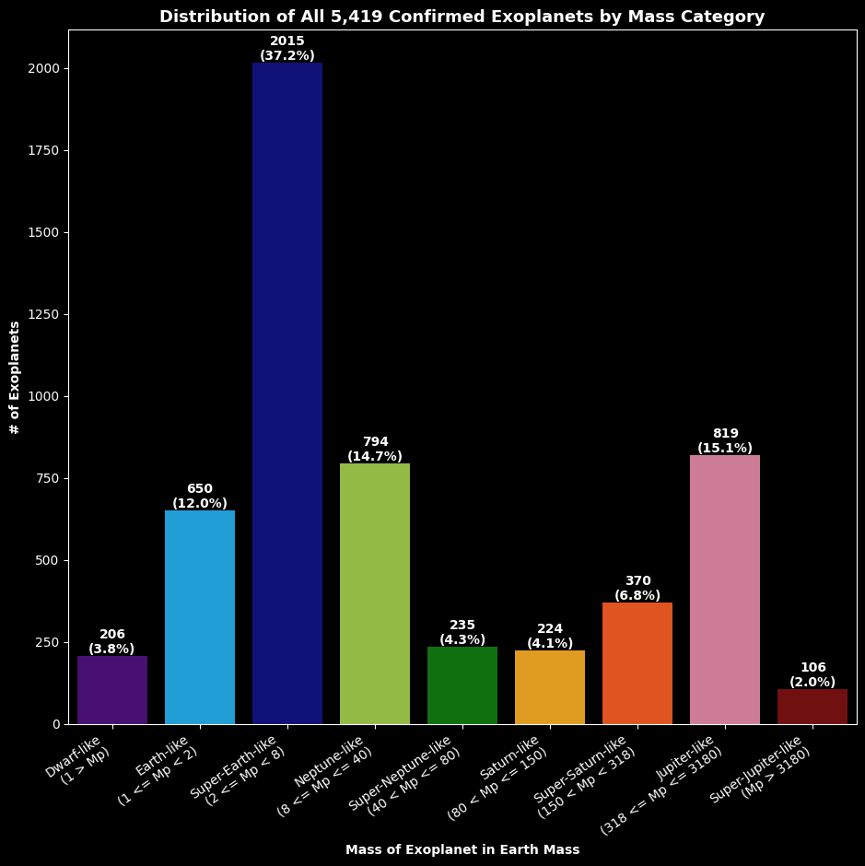
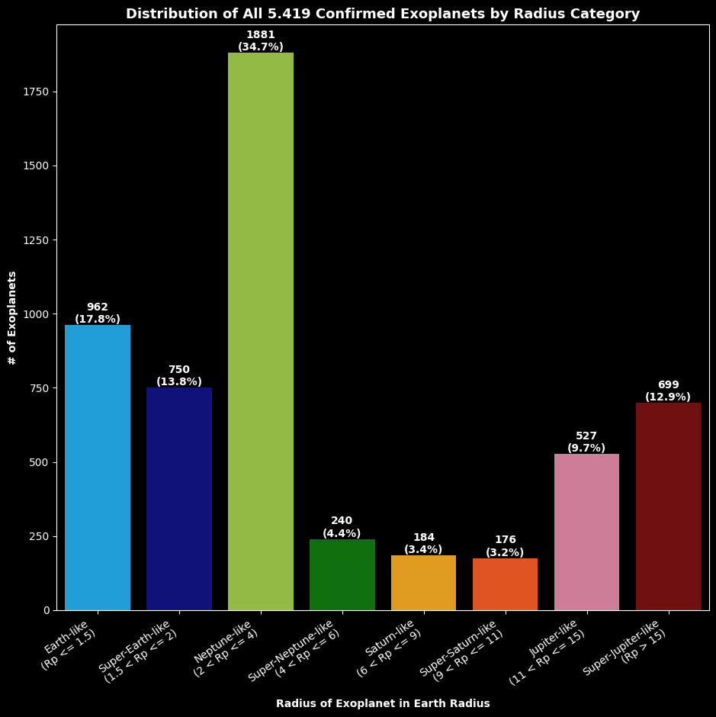
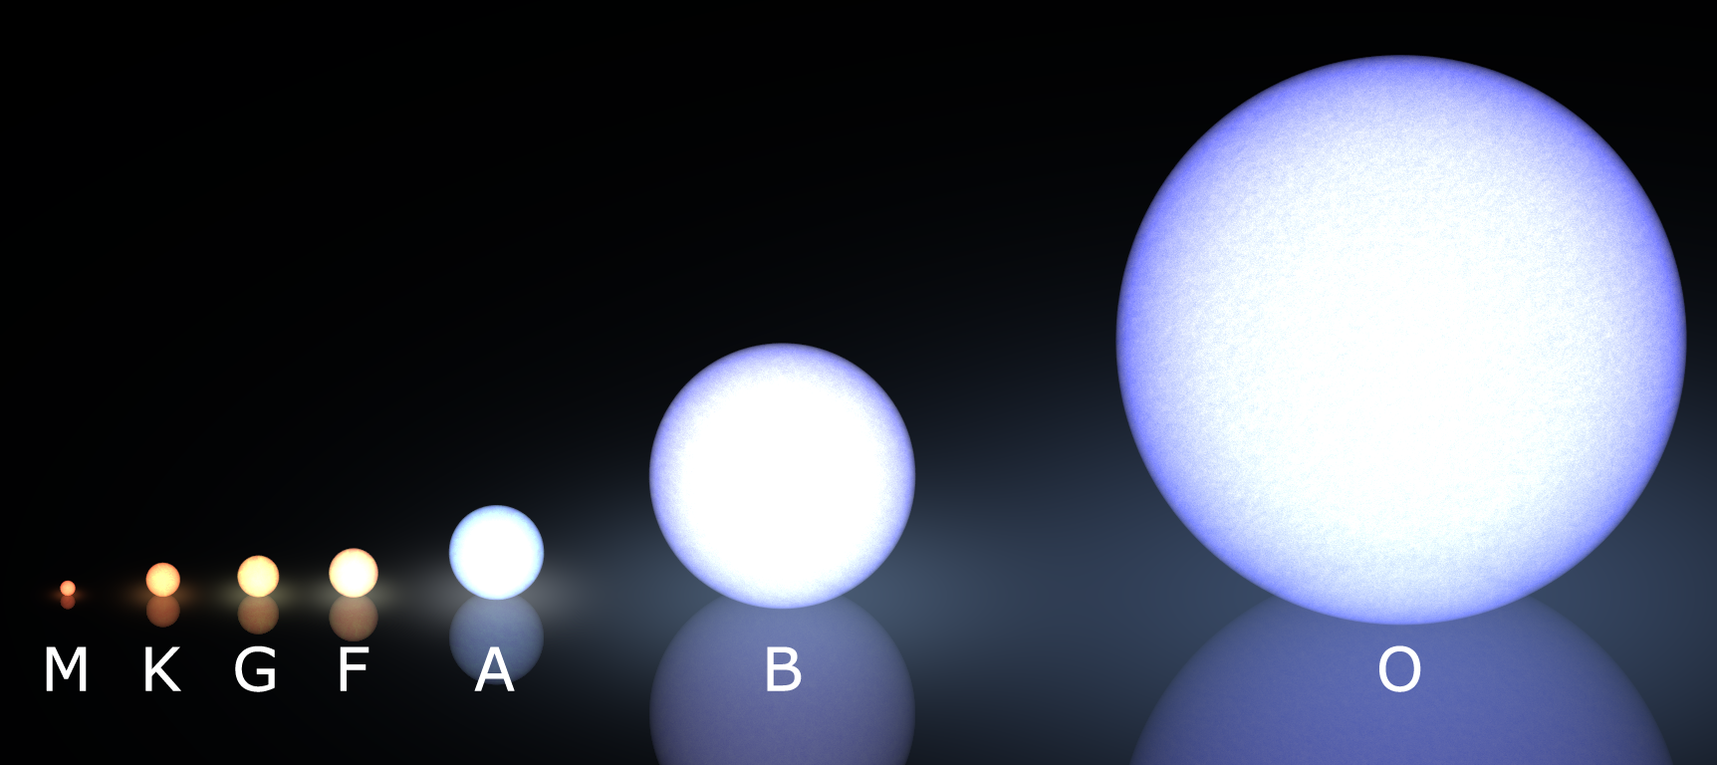
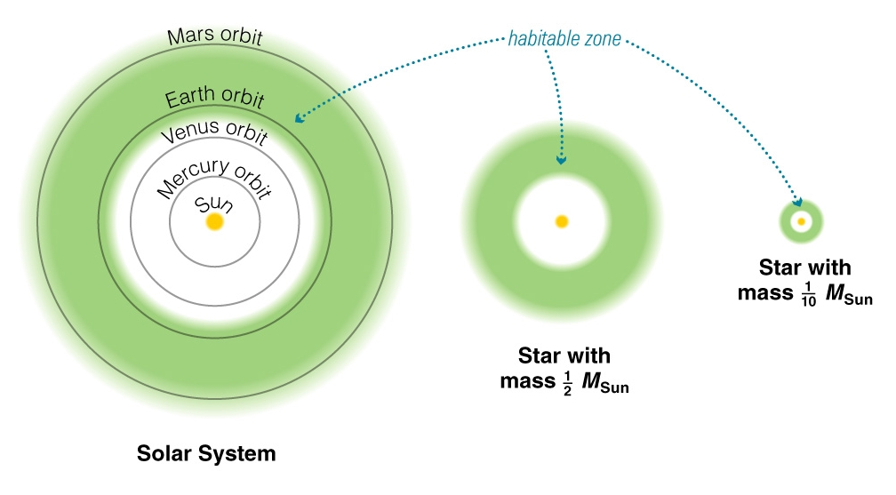
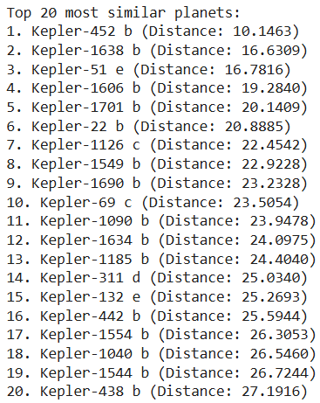
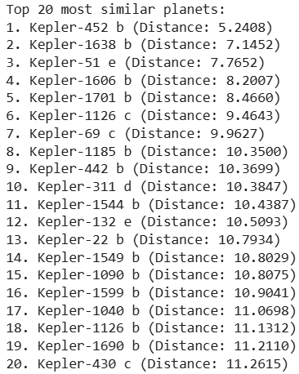
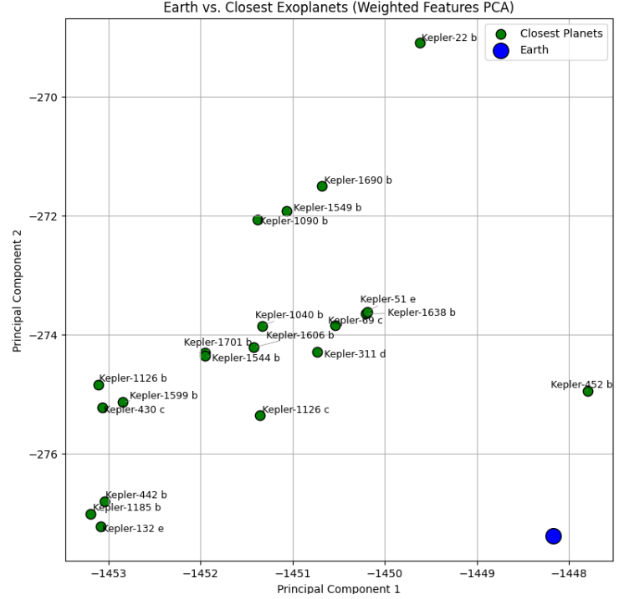
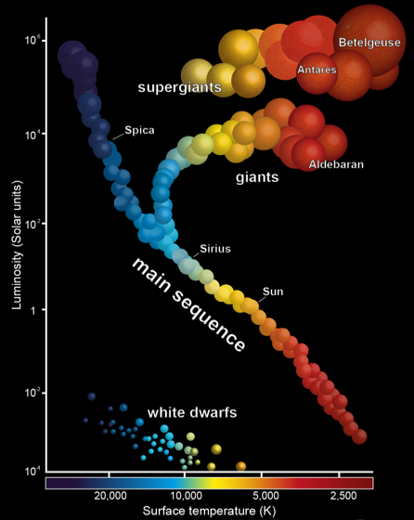
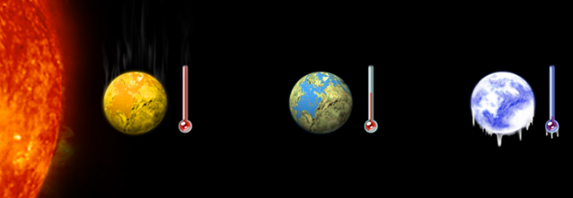
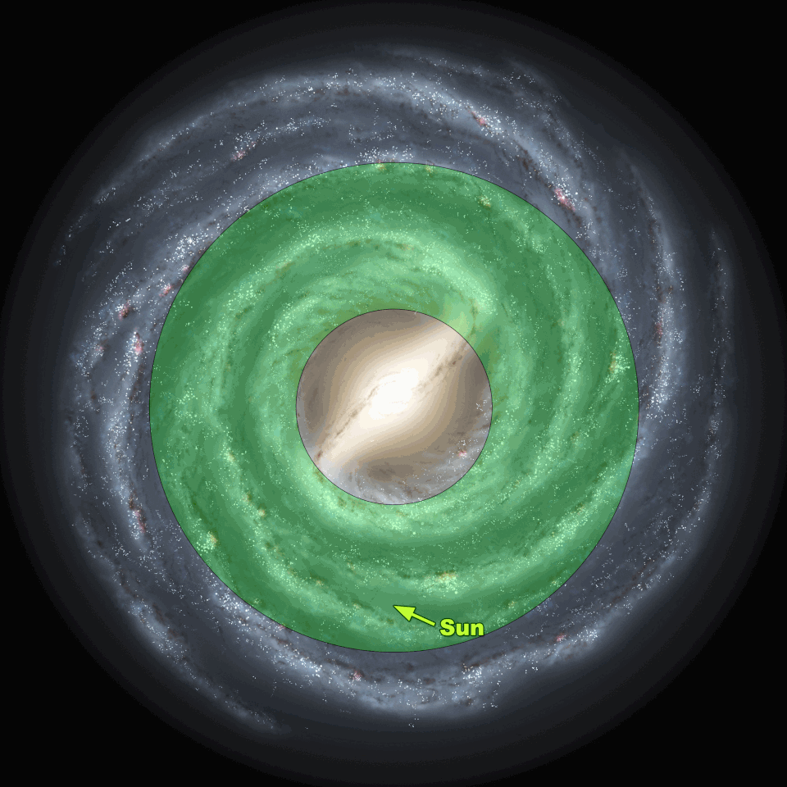
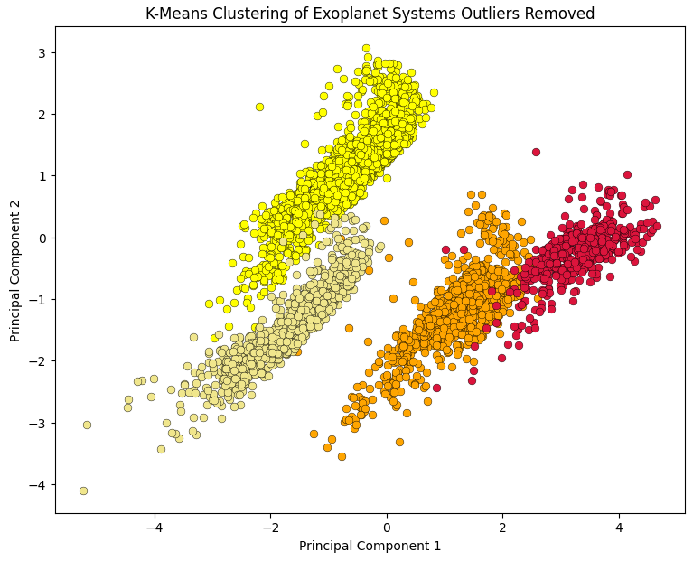
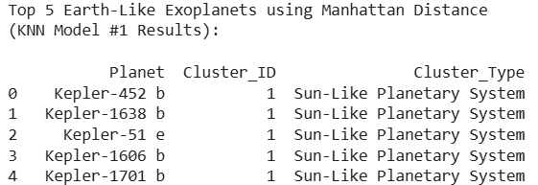
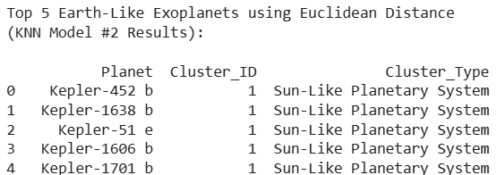
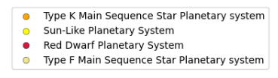
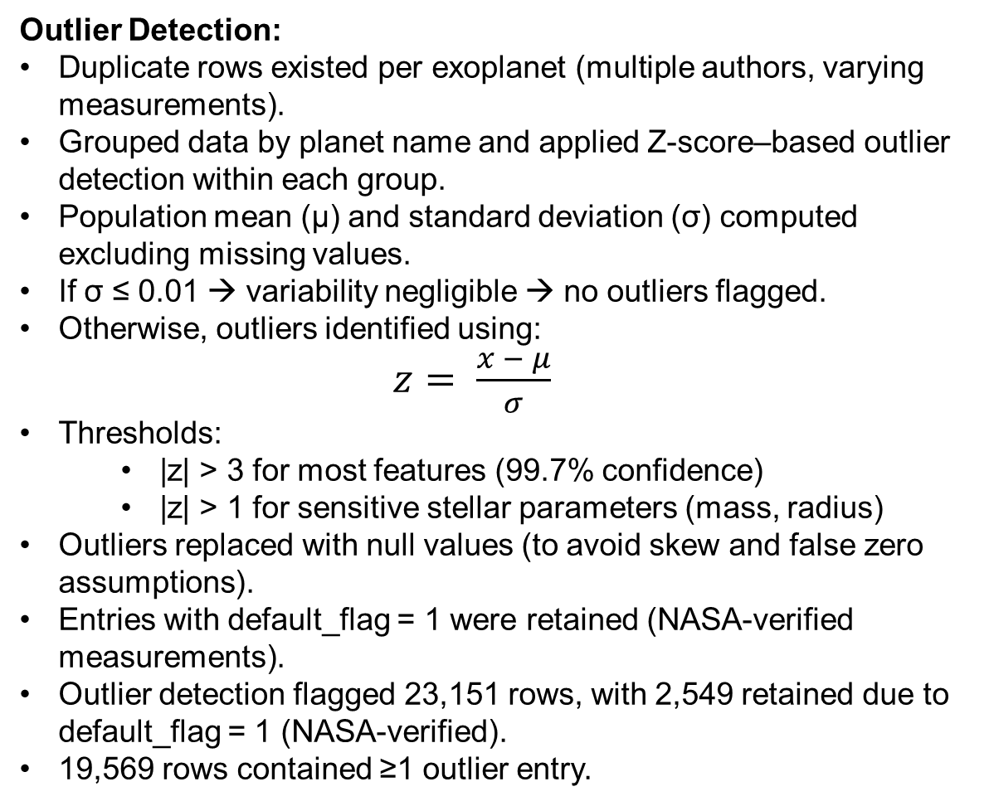
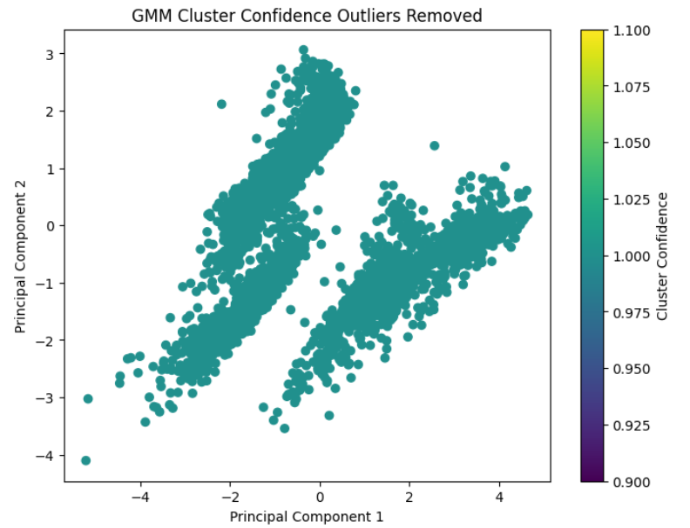
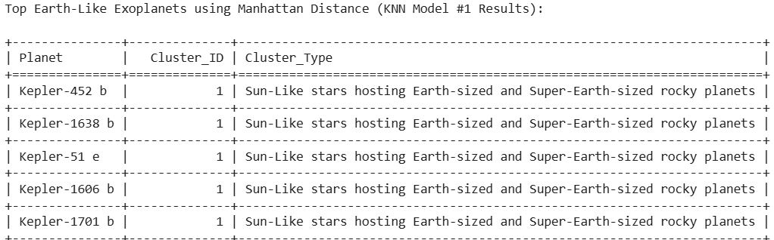
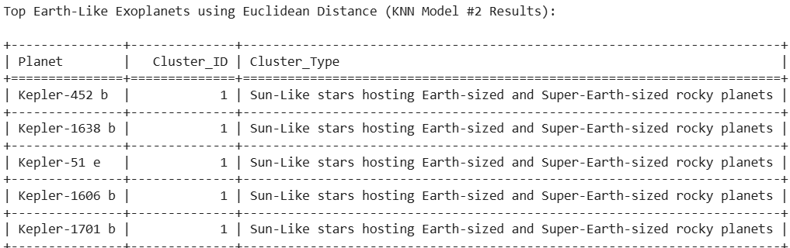
Predicting Earth-Like Similarity in Exoplanets Using Machine Learning
Samia Mahmood, Dr. Sayani Sarkar, and Dr. Andrew Karem (Bellarmine University)
smahmood@bellarmine.edu, ssarkar@bellarmine.edu, akarem@bellarmine.edu
Abstract
With the discovery of exoplanets revolutionizing our understanding beyond our solar system, the ability to systematically analyze large-scale astronomical datasets has become increasingly important in characterizing exoplanets. This project will analyze data from NASA’s Exoplanet Archive dataset which contains over one million data points and over 6,071 confirmed exoplanets discovered by space- and ground-based missions. This project will apply a structured, scalable, and reproducible data analytics framework with four machine learning models to conduct predictive analysis using classification and clustering. This project will predict Earth-Like similarity in exoplanets and their habitability potential by identifying the top 20 Earth-Like exoplanets based on feature similarity between key planetary and stellar features and Earth and Sun features respectively using K-Nearest Neighbor (KNN) classification. This project will characterize the top 20 Earth-Like exoplanets into planetary categories based on their natural groupings using clustering algorithms including K Means Clustering, Gaussian Mixture Model (GMM), and Hierarchical Density-Based Spatial Clustering of Applications with Noise (HBDSCAN). This project will demonstrate the application of computational modeling in Astronomy and Astrophysics analyses to provide meaningful insights into exoplanet characteristics and accelerate the discovery process of exoplanets.
Handling Duplicate Observations:
Aggregated duplicates:
  Numerical features → mean
  Categorical features → mode
Final dataset: 6,071 confirmed exoplanets (Jan 2026)
Missing Data and Imputation:
Missing values for key features imputed using relevant astronomical formulas
Feature Engineering:
Creation of the Stellar Luminosity, Planet Radial Velocity, and Habitable Zone columns using astronomical formulas
Final Data Cleaning:
Removed rows with excessive missing data
Removed columns whose missing data was not imputable
Final Dataset (Fig. 6):
5,419 confirmed exoplanets remain
16 key features
Supervised Learning - K Nearest Neighbor (KNN) Models:
Applied K-Nearest Neighbors (KNN) to identify the top 20 most Earth-like exoplanets.
Each planet compared to a synthetic “Earth” reference point in feature space.
Similarity measured via distance → smaller distance → closer to Earth → more Earth-Like.
Two KNN models implemented using Minkowski distance:
  KNN Model #1 - Manhattan distance (p = 1) → penalizes for deviations between a given feature
  KNN Model #2 - Euclidean distance (p = 2) → considers similarity for all features combined
  KNN used as a similarity ranking method, rather than traditional classifier.
Heavier weights applied to features with greater importance for determining Earth-Like similarity and habitability
Unsupervised Learning – K-Means Clustering Models:
Used K-Means clustering to identify natural groupings of exoplanets into their planetary systems based on feature similarity.
Model then applied to the top 20 Earth-like planets (from KNN Models) to determine their cluster membership.
Partitions data into k clusters by minimizing within-cluster variance
Reveals underlying structure in exoplanet populations
Data preprocessing:
  One-hot encoding for categorical features
  Feature scaling applied
Two K-Means models:
  Model 1: Includes outliers, k = 6 clusters
  Model 2: Removes outliers, k = 4 clusters
Unsupervised Learning – Gaussian Mixture Models (GMM):
Applied GMM clustering to capture more flexible, overlapping exoplanet groupings.
Unlike K-Means, GMM models probabilistic cluster membership.
Data preprocessing:
  One-hot encoding (categorical features)
  Feature scaling
Two GMM models:
  Model 1: Includes outliers
  Model 2: Removes outliers
Unsupervised Learning – Hierarchical Density-Based Spatial Clustering HDBSCAN
Applied HDBSCAN to identify clusters of varying density while separating noise/outliers.
Detects clusters of different shapes and densities
Automatically identifies noise points
Introduction
Advances in space missions and computational methods have significantly expanded exoplanet discovery and analysis. Since the launch of NASA’s Kepler mission in 2009, followed by K2 and TESS, over 6,701 confirmed exoplanets have been identified, generating large, complex datasets. However, the high dimensionality, variability, and missing data present challenges for characterizing planets and assessing Earth-like similarity and potential habitability.
This study applies machine learning and exploratory data analysis (EDA) on the NASA Exoplanet Archive dataset which contains planetary and stellar features of exoplanets and their host stars. This study will conduct Earth-Like similarity prediction to identify top Earth-like candidate, evaluate their habitability potential, determine their natural planetary groupings, and classify them based on key planetary and stellar features. Unlike prior work focused primarily on supervised learning, this study integrates both supervised and unsupervised methods for similarity ranking and clustering.
An Earth-Like exoplanet capable of sustaining life is determined by whether it is a rocky Earth-sized or Super-Earth-sized planet orbiting Sun-like (G-type) Main Sequence stars within the star’s Habitable Zone (HZ) inside the Galactic Habitable Zone (GHZ) of the Milky Way Galaxy in accordance with established Astro biological models. Exoplanet’s host stars are classified by the star types: M, K, G (Sun-like), F, A, B, or O where star types earlier than type F are unlikely to support life due to their short lifespans (Fig. 1). Host stars are also classified by their luminosity class based on the Hertzsprung-Russell diagram. This includes Main Sequence (V) stars, Sub-Giants (IV), Giants (III), Bright Giants (II), Super Giants (I), and White Dwarfs (WD) (Fig. 2).
The star’s Habitable Zone depends on the star type (Fig. 3) and describes the optimal distance between the exoplanet and its host star range for liquid water to be sustained which is required for habitability (Fig. 4). Earth-Like similarity depends on a distance within 1 AU. The Galactic Habitable Zone (GHZ) refers to the area within the Milky Way Galaxy which can sustain life due to reduced radiation (Fig. 5).
Figure 13: Graph shows 16 clusters identified by the HDBSCAN model for all exoplanets where outlier exoplanets automatically removed.
Figure 14: Graph shows 16 clusters identified by the HDBSCAN model for all exoplanets where outlier exoplanets and exoplanets with membership probability < 90% automatically removed.
Key Feature | Definition
Planet name | Name of exoplanet
Star number per system | Number of stars in the exoplanet’s solar system
Orbital period | The time it takes an exoplanet to complete one revolution around its host star (measured in Earth days)
Orbital semi major axis | The distance between an exoplanet and its host star (measured in AU – Astronomical Unit which refers to the distance between the Earth and the Sun)
Planet radius | Radius (size) of exoplanet (measured in Earth Radius)
Planet mass | Mass of exoplanet (measured in Earth Mass)
Orbital eccentricity | Describes how elongated (elliptical) the orbit of an exoplanet is.
Planet equilibrium temperature | Exoplanet equilibrium (average surface) temperature (measured in terms of Kelvins)
Spectral type | Host star classification based on star's luminosity class (Main Sequence, Sub-Giant, Red Giant, Super Giant, White Dwarf, Brown Dwarf) and star type (M, K, G, F, A, B, O)
Stellar effective temperature | Host star’s effective (surface) temperature (measured in terms of Kelvins)
Stellar radius | Radus (size) of host star (measured in Sun Radius)
Stellar mass | Mass of host star (measured in Sun Mass)
Stellar surface gravity | Surface gravity of the host star which describes the strength of the gravitational force acting on the surface of the host star
Planet radial velocity | Describes the motion of the exoplanet relative to its host star
Stellar Luminosity | Describes how much energy is emitted from the star based on its apparent brightness
Habitable Zone | If the exoplanet is within its host star’s habitable zone (binary yes=1, no=0)
Figure 15: Bar Chat of the Distribution of all 5,419 Extrasolar Stars Characterized by spectral type
Figure 16: Bar Chat of the Distribution of all 5,047 Main Sequence Extrasolar Stars Characterized by spectral type
Figure 6: Table shows all 16 key planetary and stellar features and their definitions
Results
KNN Model #1 (Manhattan Distance)
KNN Model #2 (Euclidean Distance)
Figure 1: Diagram shows the different star types in order of coldest and longest lifetime to hottest and shortest lifetime
Figure 3: Diagram shows the location of the Habitable Zone which depends on the star type
Figure 17: Bar Chart of Mass Characterization for all 5,419 Exoplanets which orbits a Main Sequence (V), Sub Giant (IV), Red Giant (III) Host Star.
Figure 18: Bar Chart of Radius Characterization for all 5,419 Exoplanets which orbits a Main Sequence (V), Sub Giant (IV), Red Giant (III) Host Star.
Conclusion and Future Work
Based on the KNN model, the most Earth-Like exoplanet is found to be Kepler-452 b with the shortest Euclidean and Manhattan distance. This is followed by Kepler-1638 b, Kepler-51 e, Kepler-1606 b, and Kepler-1701 b.
Based on the natural planetary groupings identified by the K-Means Cluster, GMM, and HDBSCAN models, all top 5 exoplanets are likely rocky Earth-sized or Super-Earth-sized planets orbiting a Type-G (Sun-Like) star within the Habitable Zone of its star within the Galactic Habitable Zone. Thus, making the top 5 Earth-Like planets potentially habitable.
When evaluating both KNN models, the top five Earth-like exoplanets remained consistent across both weighted Manhattan and Euclidean KNN models, indicating a robust core of high-confidence Earth analogs. This is supported by Fig. 8 which shows close clustering around Earth. However, three planets differed within the top twenty, showing that mid-tier candidates are sensitive to the choice of distance metric, particularly in less constrained regions of feature space. This suggests that similarity rankings become less stable beyond the top candidates. The comparison highlights complementary insights: Manhattan distance captures overall feature similarity, while Euclidean distance emphasizes minimizing individual deviations, reinforcing that only the highest-ranked planets should be considered the most reliable Earth analogs.
K-Means Clustering, GMM, and HDBSCAN all successfully identified the natural planetary groupings of all confirmed exoplanets. The models produced consistent results for the top 20 Earth-Like exoplanets found by both KNN models which solidifies validity of results.
While K-Means classified planets based on their stellar features, GMM expanded on this to include planetary features based on planet radius, mass, and equilibrium temperature. The high membership probability indicates that the GMM was confident in correctly assigning exoplanets to clusters. The HDBSCAN model expanded on both K-Means Clustering and GMM by assessing the membership probability for each cluster and demonstrated high probabilities between 85% to 100% confidence in clustering assessment for all exoplanets.
Conducting an EDA on the data revealed that a majority of all confirmed exoplanets may potentially orbit a Type-G (Sun-Like) star, are Super-Earth-Like in radius, and Neptune-Like in mass.
Future work will explore the use of additional unsupervised learning models to predict habitability potential for all exoplanets and rank exoplanets by their habitability potential.
Figure 4: Diagram depicts an artist rendition showing an exoplanet too hot to sustain water, too cold to sustain water, and Earth which holds water.
Figure 7: Table shows the top 20 Earth-Like exoplanets found from the KNN Model #1 (Manhattan Distance) and KNN Model #2 (Euclidean Distance). The top 5 Earth-Like exoplanets remain consistent showing robustness.
Figure 8: Graph which depicts the top 20 Earth-Like exoplanets (shown in green) in proximity to Earth (shown in blue). The high dimensional data (34 total features) are reduced into Principal Components 1 and 2 (2 features) for visualization purposes.
K-Means Clustering Results for Top 5 Earth-Like Exoplanets
Figure 2: Diagram shows the different luminosity classes and the life stages for stars
Figure 5: Diagram shows the Galactic Habitable Zone of the Milky Way Galaxy
Objective
Supervised machine learning using KNN → Predefined target row corresponding to Earth used to compare all planetary and stellar features of all exoplanets to Earth and the Sun respectively. Will automatically produce a list of the top 20 Earth-Like exoplanets and insight into their habitability potential.
Unsupervised learning using K Means Clustering, GMM, and HDBSCAN → Predict exoplanet’s Earth-Like similarity by identifying their natural planetary groupings without a predefined planetary labels. The results from all three clustering models will be compared to evaluate overall result robustness.
Exploratory data analysis → Explores relationships between stellar and planetary features and classify exoplanets into specific categories through an analysis of their key features.
Materials and Methodology
Figure 9: Graph shows the 4 clusters identified by the K-Means Cluster model for all confirmed exoplanets with 535 outlier exoplanets removed due to anomalous features present.
Figure 10: Table shows the K-Means Clustering model correctly predicted the top Earth-Like exoplanets found from the KNN Model #1 and KNN Model #2 belongs to a Sun-Like Planetary System
Software Tools:
Programming Language: Python
Development Environment: Jupyter Notebook
Initial Preprocessing Steps:
Raw dataset: 39,235 rows × 92 columns of exoplanet observations from ground- and space-based telescopes.
Removed redundant features and renamed variables → 21 columns retained.
Analytical Challenges Present in Data:
Duplicate rows for a single exoplanet
Redundant attributes
Missing data of important attributes
Typographical errors
Filtering Unconfirmed Exoplanets (TESS candidates):
Controversial planets (controversy_flag = 1)
References
NASA Exoplanet Archive. NASA Exoplanet Archive: Planetary Systems Composite Data. 2026. Available online: https://exoplanetarchive.ipac.caltech.edu/ (accessed on 11 January 2026).
S. Mahmood, I. Rahman, S. Sarkar, and A. Mahmood. (2026). Discovering Earth 2.0: A data-driven exploration of NASA’s Exoplanet Dataset. *Proceedings of the IEEE International Conference on Artificial Intelligence, Computer, Data Sciences and Applications (ACDSA 2026)*. (Accepted for publication).
S. Sen, S. Agarwal, P. Chakraborty, and K. Singh, “Astronomical big data processing using machine learning: A comprehensive review,” Experimental Astronomy, vol. 53, no. 2, pp. 333–368, 2022.
W. Borucki, D. Koch, G. Basri et al., “The Kepler mission: Finding the sizes, orbits and frequencies of earth-size and larger extrasolar planets,” in Scientific Frontiers in Research on Extrasolar Planets, ser. ASP Conference Series, vol. 294, 2003
C. H. Lineweaver, Y. Fenner, and B. K. Gibson, “The galactic habitable zone and the age distribution of complex life in the milky way,” Science, 2004.
J. F. Kasting, R. Kopparapu, R. M. Ramirez, and C. E. Harman, “Remote Life Detection Criteria, Habitable Zone Boundaries, and the Frequency of Earthlike Planets around M and Late-K Stars.” Proceedings of the National Academy of Sciences (PNAS), vol. 111, no. 35, pp. 12641-12646, 2013.
Figure 11: Graph shows the 4 clusters identified by the GMM which are consistent with the K-Means model. This shows the confidence of the model in assigning all exoplanets to their appropriate clusters. Most planets have >99% probability of belonging to the correct cluster.
Figure 12: Table shows the GMM correctly predicted the top Earth-Like exoplanets found from the KNN Model #1 and KNN Model #2 belongs to a Sun-Like Planetary System and identified the specific planet size and Earth-Like/Super-Earth-Like

